Slide 1
Completing a United Way Campaign Report Envelope

Slide 2
Fill in the name of your company, number of employees, company address, phone & fax.
Include your name, email address and phone number in case United Way has questions.
Lets get started!
This is a step by step guide on completing a Campaign Report Envelope.

Slide 3
Insert the amount of the corporate pledge.
How much of the Corporate Gift are you paying today?
Insert the number of donors. How many payroll deduction pledge forms do you have?
Insert amount of payroll deduction pledges. What is the total Payroll gift?
Complete the corporate and payroll deduction sections.

Slide 4
Insert the amount of the bill at home total pledge.
Insert the number of bill at home donors
This box will be blank. These donors will be sent bills at their home quarterly.
Complete the Bill At Home Section.

Slide 5
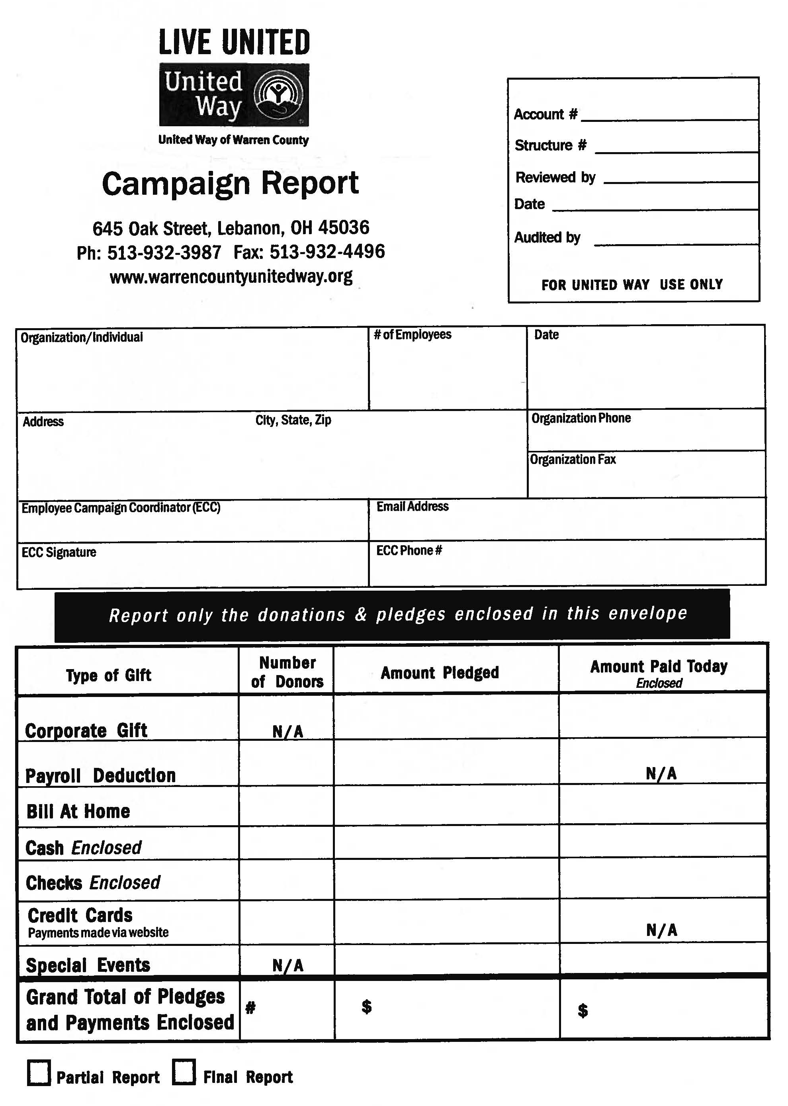
Insert the amount of Cash pledged.
Insert the number of donors giving cash.
Complete the Cash giving section.
Insert the amount of Cash enclosed in this envelope.

Slide 6
Enter the amount of pledges made by check.
Insert the number of donors giving by check.
Insert the tally of all employee check gifts enclosed.
Complete the Check giving section.

Slide 7
What is the total amount of credit card pledges.
This will be blank, as it was processed by the employee online at www.warrencountyunitedway.org
via Paypal.
How many employees turned in pledge forms indicating a gift by credit card.
Tally the number of credit card pledge forms and the amount of the combined gift.

Slide 8
Complete the Special Events Section.
How much did you raise in Special Events.
How much Special Event money (Cash or checks) is enclosed in this envelope.

Slide 9
Complete the Grand Total Section.
This is a tally of the total pledges for your campaign. Note: This is the pledge amount. The Amount Paid is the next column.
This is a total of the Number of Donors. Simply tally this column.
This is a total of what is enclosed in this envelope today.

Slide 10
If you anticipate turning in more pledge forms, check the “Partial Report” box.
If your campaign is complete, check the “Final Report” box.

Slide 11
We hope you found this helpful. If you have any questions, please feel free to contact the United Way of Warren County at 513-932-3987. www.warrencountyunitedway.org

